Slide 1


Slide 2


Slide 3

Welcome to Ms Cissy’s English Class!
Course Title: College English - Basic Level I – A level

Slide 4
Course Description

Slide 5
Learning
Strategy
Skills
What to learn
Cross Culture Communication
Knowledge

Slide 6
Target
4 Abilities
5 Learning
训练四种能力
Critical thinking ability
Analytical ability
Problem-solving ability
Self-development ability
培养五会人才
Learn how to think
Learn how to learn
Learn how to apply
Learn how to survive
Learn how to develop

Slide 7
Study Skills
3. Information-locating skills
Know where to find specific
Information
Determine the relevant parts
Of a book
Find the reference for a topic
Read for the gist of an article
(skimming)
Read for specific details in an
Article （scanning）
4. Coping with extended use
Of English
Know the criteria for note-taking
State my reading strategies
Prediction in reading and listening
Use organizational cues to aid
Understanding
Infer hidden meaning
Cope with unfamiliar grammar
In contest

Slide 8
Study Skills
5. Discussion Skills
Get my ideas across
Organize/illustrate my ideas
Build on what others have said
Use phrases that express
Agreement/disagreement
Paraphrase what a previous
Speaker has said
Take active and responsible
Part in discussion
6. Academic writing
Skills
Integrate reading into
Writing
Make an outline
Select relevant ideas
Order ideas logically
Can redraft
Stick to the point
Write introduction…
Get the tone right
Quote correctly
Make heading
Avoid plagiarism

Slide 9
Study Skills
7. Research skills
Recognize representative sample
Select simple random samples
Associate research within
a context
Discuss reliability in research
Record simple research findings
Read pie charts(圆形分析图)
and bar graphs(条型图)
Calculate averages
Recognize normal distribution
Curve
Write introduce \analysis\
Description\conclusion
8. Examination skills
Use strategies appropriate to
the kind of assessment
Manage study time
Use variety of memory aids
Have positive study routine
Cope with pre-exam stress
Manage exam time
Cope with exam stress
Learn from exam mistakes
Understand the marking system
Use exam for self-evaluation

Slide 10
4 Dimensional Learning Method
Phonetics
Corpus
Sentences-pattern
-native & natural
Culture
Notes:
Phonetics: l , i;i:,dialect
Corpus: police-cop, crash, eye-candy
Sentences: would you mind taking me to the bus station?

Slide 11
When English meets Dialect (Tianjiness)
Congratulations!
Hello!
Notes:
李宁 Anything is possible！
雀巢咖啡 The taste is great！
飘柔 Start ahead.
麦当劳 I’m lovin’ it!
美特斯邦威 Don't walk the common way.

Slide 12
A: When I told my mom I would be home around 2 am, she has a cow!
B: Duh!

Slide 13
New semester outlook
This fall semester falls on September 16th.There will be 17 weeks in total till the end of this semester. Among them, 10 weeks for teaching and 2 weeks for review and oral test. The 18th & 19th week is scheduled for written final test.
本学期开学时间为2019年9月16日,结课时间为2019年12月27日,共17周。基础段教学周为第3-16周，其中国庆节放假一周，复习，口语考试共两周，实际授课周数为12周，第18-19周为期末考试周。本学期我们的课程名称为“基础英语 I”。

Slide 14
Special Feature 课程特色
1) Advanced Concept
Student centered : group team work presentation students as social being\ man of certain culture
Communicative skill focused
Language context approach
Study process oriented rather than result oriented
Method based
2) Practical Methods : discussion; role-play; presentation; interview
Communication ( team work )

Slide 15
Teaching Requirement（教学要求）
混合式教学模式。线上教学、线下面授、线上+线下个性化教学。
线上教学：发布相关视频、音频、文本等形式的学习资源供学生学习，布置与教学资源相匹配的学习任务，如练习、测试、在线讨论等。建议利用扇贝听力、英语流利说等APP，布置学习任务，监督学生学习。
线下课堂面授：教师设计以互动为特点的课堂学习活动，帮助学生实现由知识到运用的能力转变。
线上+线下个性化教学：
（1）授课教师根据不同学生需求，配合具体教学内容，适时以线上或线下的方式给予学生专题性指导或帮助式反馈
（2）条件允许情况下，由外教开设不同主题的小班工作坊，主题包括语言技能、学术英语技能和跨文化知识等

Slide 16
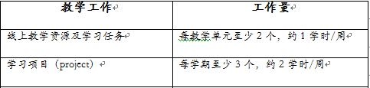
Teaching Requirement（教学要求）

Slide 17
The selected books（课本选择）
Required textbooks
College English Integrated Course Book 1
New Experiencing English 1
Supplimentary Books for Reading & Listening
-- English Through Culture 1
-- College English Integrated Course Book 1
-- New Standard College English 1
Recommended ARTICLES for Reading
Reader’s Digest
New Yorker
Time Magazine

Slide 18
Time Allocation（时间安排）
周数 | 授课内容
3 | New-Term Outlook Integrated Course 1: Unit 1 Growing Up
4 | Integrated Course 1: Unit 1 Growing Up
5 | New Experiencing English 1: Unit1 A Life Lesson from A Volunteer Firefighter
6 | Learning to Think I
7 | Learning to Think II

Slide 19
Time Allocation（时间安排）
周数 | 授课内容
8 | Term Project
9 | New Experiencing English 1: Unit3 An Escape from Poverty
10 | Integrated Course 1: Unit4 The American Dream
11 | Integrated Course 1: Unit4 The American Dream
12 | New Experiencing English 1: Unit4 Don’t Eat the Marshmallow

Slide 20
Time Allocation（时间安排）
周数 | 授课内容
13 | Integrated Course: Unit6 Romance
14 | Integrated Course: Unit6 Romance
15 | New Experiencing English 1: Unit6 Talk Nerdy to Me
16 | Oral Exam
17 | Oral Exam
18 | Final Written Exam: 30th Dec. 10:00-11:40

Slide 21
Accomplishment evaluation（成绩评定）
The student's semester work is worth 40% of his/her final course grade.
Formative Assessment: 40%
Project & Presentation(presentation, writing task, project report, group discussion, lecture, book report, E-zine, role play, drama play, dubbing & etc.):35%
Attendance: 5%
Summative Assessment: 60%
Oral test(paragraph reading, answering Qs, debating, group discussion, role play, conversations & etc.): 10%
Final exam: 50%
Final
Oral test: 10’
Final exam: 50’

Slide 22
Attendance （考勤）
Their rules
学生按照统一安排在规定的班上课，并进行考勤，不得私自调班。
学生请假必须以书面形式提出，并在上课前交给任课老师，由任课老师签名批准方可生效。
本学期点名5次，学生每旷课一次扣2分。旷课次数达3次以上者予以警告，通报该生所在院系，并要求其做出书面解释，旷课严重者（5次点名均不到者）按学校有关规定不能参加本课程的有关考试，本课程视为不及格。

Slide 23
Presentation (课前演讲)
presentation (10’)
2ppl/group
will assign each group a topic ahead of the presenting week

Slide 24
Autonomous Study（自主学习）
第3-4周：
自主拓展巩固学习：《大学英语综合教程 1》Unit 2 Friendship
自主拓展巩固学习：《新标准大学英语视听说 1》Unit 2 Food, Glorious Food!
第5-6周：
自主拓展巩固学习：《大学英语综合教程 1》Unit 3 Understanding Science
自主拓展巩固学习：《新标准大学英语视听说 1》Unit 5 All You Need is Love
第7-8周：
自主拓展巩固学习：《大学英语综合教程 1》Unit 5 Work to Live or Live to Work
自主拓展巩固学习：《新标准大学英语视听说 1》Unit 6 Shop Till Your Drop
第9-10周：
自主拓展巩固学习：《大学英语综合教程 1》Unit 7 Animal Intelligence
自主拓展巩固学习：《新标准大学英语视听说 1》Unit 7 Family Matters
第11-12周：
自主拓展巩固学习：《大学英语综合教程 1》Unit 8 Educational Problems
自主拓展巩固学习：《新标准大学英语视听说 1》Unit 9 Body and Mind
第13-14周：
自主拓展巩固学习： 《文化透视英语教程 1》Unit 1 Voices from the Family
第15-16周：
自主拓展巩固学习：《文化透视英语教程 1》Unit 2 The House Divided

Slide 25
Examination schedule（考试安排）
本学期将安排口语考试和期末考试，具体时间另定。
1）oral test：2 weeks before final
2）Final exam： 2019年12月30日 （周一）10：00 -11:40（暂定）

Slide 26
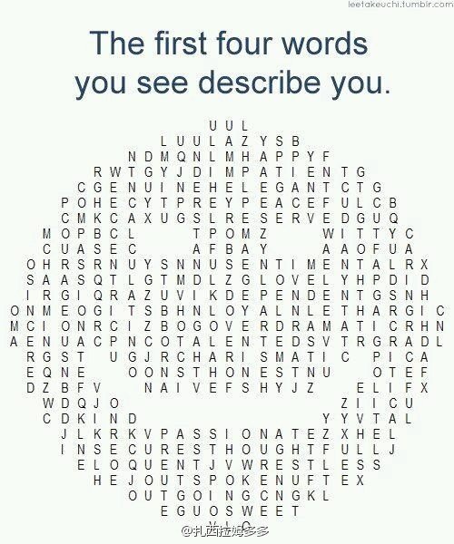

Slide 27
Time to think…
What sort of life you are having right now?
What kind of life you are expecting to have in the near future?
How could you define perfect life? Could you make some figures to illustrate it?

Slide 28
4 Goals 4 the perfect life
By Brian Tracy (Jan. 5th, 1944-)
dropping out of high school before graduation
attained the status of top salesman at 1st year as sales; was made a Vice President in charge of 95 people at the end of 2nd year.
President of Brain Tracy Learning Systems & Chairman of Brian Tracy International
assembled his "success system“ in 1981; in 1985, released an updated version of this seminar as a self-help audio tape entitled "The Psychology of Achievement".

Slide 29





Slide 30
The 1st Goal
Healthy and Fit
The first goal common to all of us is health and energy. We all want to be healthy and fit, to have high levels of energy and to live free of pain and illness. Today, with the incredible advances in medical science, the quality of our health and fitness, and our lifespan, is largely determined by design, not by chance. People with excellent health habits are far healthier, have more energy, and live longer and better than people who have poor health habits.

Slide 31
The 2nd Goal
Excellent Relationships
The second goal that we all have in common is to enjoy excellent relationships--intimate, personal or social--with the people we like and respect, and who like, love and respect us in turn. Fully 85% of your happiness will be determined by the quality of your relationships at each stage, and in each area, of your life. How well you get along with people, and how much they like, love and respect you, has more impact on the quality of your life than perhaps any other factor.

Slide 32
The 3rd Goal
Do What You Love
The third common goal is to do work that we enjoy, to do it well, and to be well paid for it. You want to be able to get and keep the job you want, to get paid more and promoted faster. You want to earn the very most that is possible for you at each stage of your career, whatever you do.

Slide 33
The 4th Goal
Achieve Financial Independence
The fourth goal we all have in common is to achieve financial independence. You want to reach the point in life where you have enough money so that you never have to worry about money again. You want to be completely free of financial worries. You want to be able to order dinner in a restaurant without using the price listings to determine what you want to eat.

Slide 34


A story…

Slide 35



Slide 36



Slide 37



Slide 38



Slide 39



Slide 40



Slide 41

Notes:
Those pic are telling us each one of us likes the characters in the pics who are living in a relatively tiny world compared to the whole
Universe. When we looking at things or doing things, we are so focused on the tiny details to miss out the whole idea.in another word,
Sometimes we just pay attention to the short-term interest, benefit rather than the long-term one.
we could use those pics to remind us to get rid of the narrow-minded ourselves down
in our Sub consciousness but to apply the global vision to look at things, you may find there will always be more angles and choices.

Slide 42
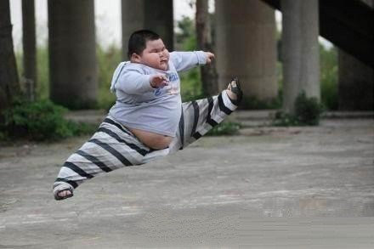
If you can dream it, you can achieve it!

Slide 43
The end Thank you!
email: guanlin@nankai.edu.cn

